Slide 1

MIDTERM PROJECT PRESENTATION
FOOD RECIPE RECOMMENDATION SYSTEM
- TEAM: 4WIZ

Slide 2
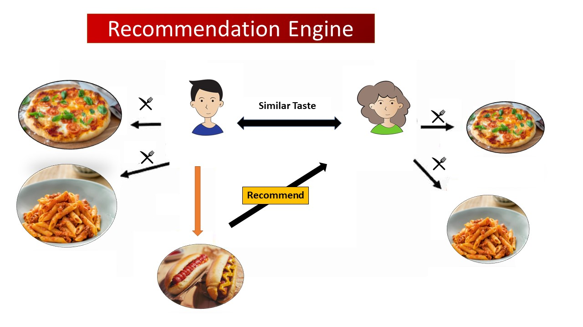



TEAM MEMBERS AND ROLES
TEAM MEMBERS :
SHANKARI SUNDARAM
MANIDEEP ABBIDI
VENKAT JEEVAN KADALI
DOLLY SRI VEMULA
PROJECT GUIDE :
Dr.ERIK FREDERICKS

Slide 3

AGENDA
1. Project Description
2. Technology
3. Project Timeline
4. Diagrams
5. Software Requirements
6. Current Implementation
7. Conclusion

Slide 4
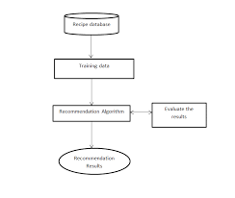
PROJECT DESCRIPTION
“From Ingredients to Delights” is a cutting-edge project that brings Indian culinary exploration to your fingertips. Whether users are navigating dietary restrictions, budget constraints, or simply seeking culinary inspiration, our platform is here to make their cooking journey hassle-free and enjoyable. Using state-of-the-art algorithms, we offer accurate and innovative recipe recommendations, ensuring that users' culinary adventures are nothing short of exceptional. Welcome to a world where creativity meets flavor, where they can explore and savor every bite.

Slide 5

TECHNOLOGY
PYTHON
HTML,CSS
JSON
FLASK

Slide 6
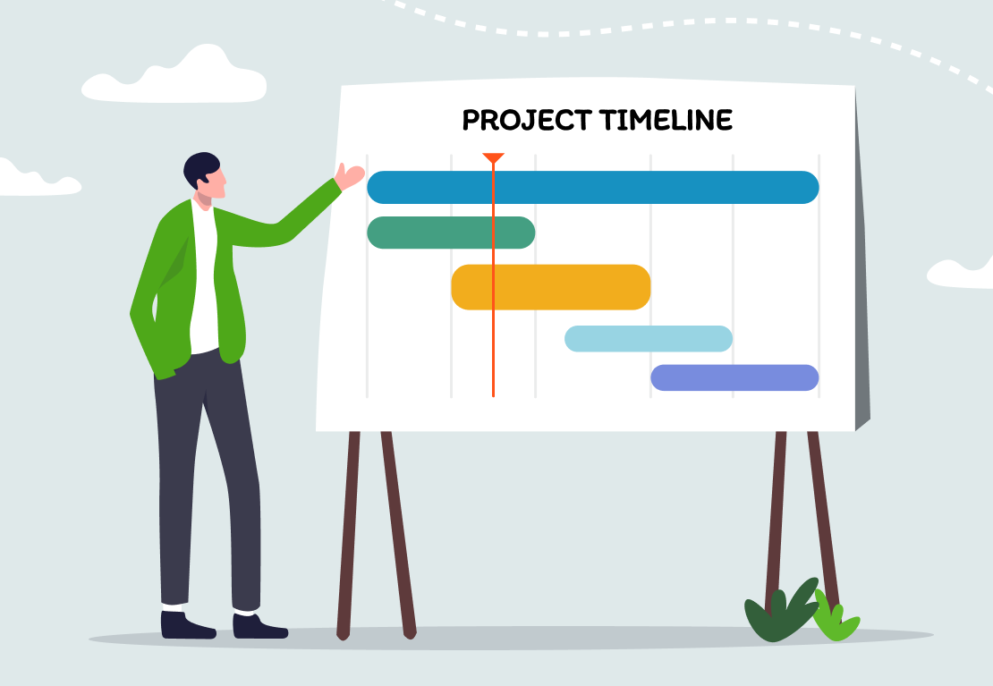
PROJECT TIMELINE

Slide 7
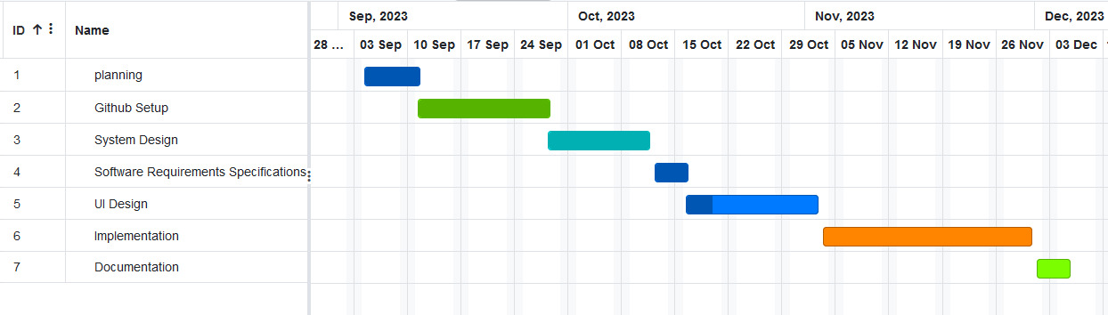
GANTT CHART

Slide 8
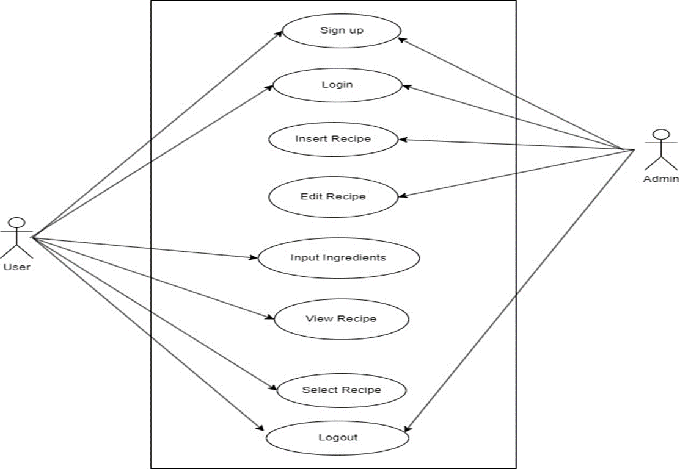
USE CASE DIAGRAM

Slide 9
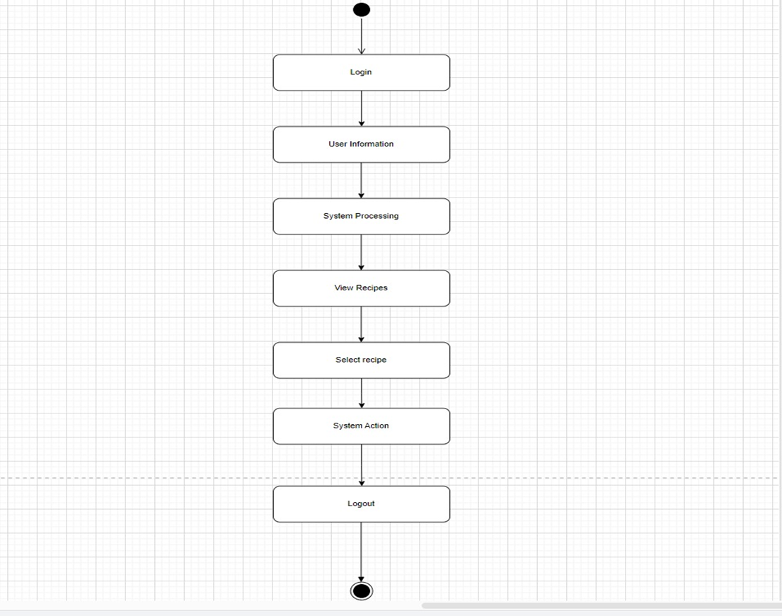
ACTIVITY DIAGRAM

Slide 10
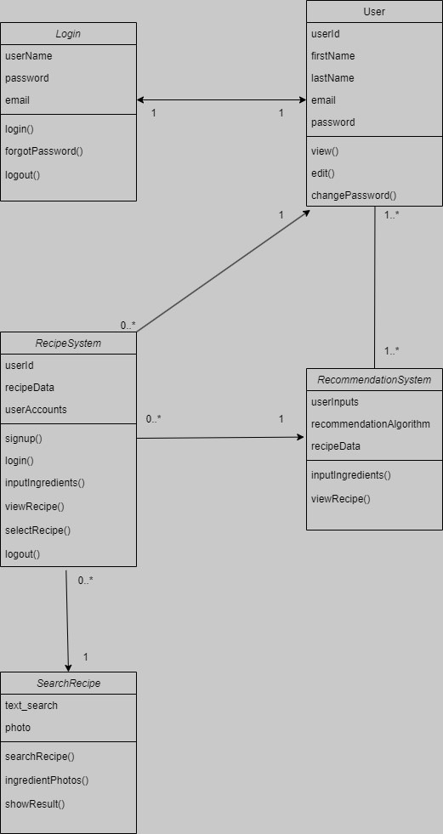
CLASS DIAGRAM

Slide 11
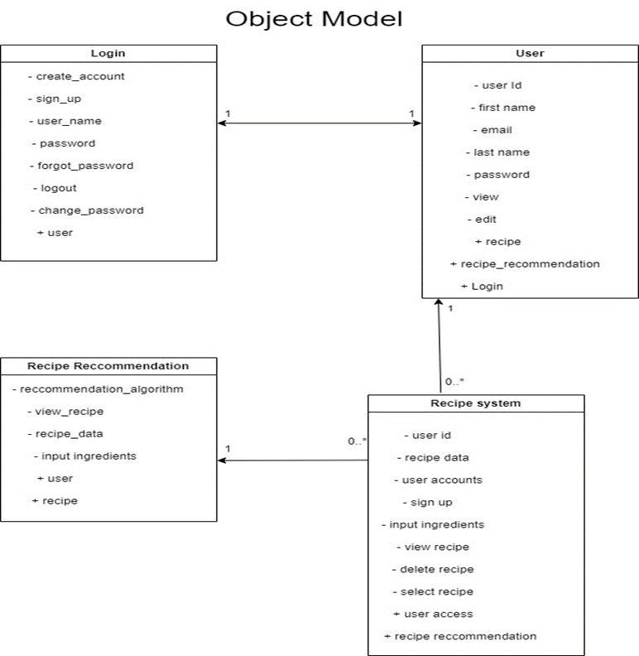
OBJECT DIAGRAM

Slide 12
REQUIREMENT(S)
Functional Requirements
User Registration and Account Management
FR1: The system shall allow users to register an account, providing their name, email, and a unique username.
FR2: The system shall allow users to log in to access the application system.
Ingredient Input and Recipe Recommendations
FR3: Users shall be able to input a list of ingredients they have or wish to use for cooking.
FR4: The system shall validate and process the user-inputted ingredients to ensure accurate and relevant recipe recommendations.
FR5: The system shall suggest ingredient substitutions for users based on their choices, accommodating dietary preferences and ingredient availability.
Recipe Search and Viewing
FR6: Users shall search for recipes based on keywords, ingredients, cuisine, or dietary requirements.
FR7: Users shall have the capability to access detailed recipe information, including ingredients, cooking methods, and nutritional data.
FR8: Users shall be able to store their preferred recipes for quick access and future reference.

Slide 13
REQUIREMENT(S)
Non-Functional Requirements
Performance and Scalability
NFR1: The system shall respond quickly to multiple users, providing recipe recommendations within 3 seconds.
NFR2: The system shall continually add new ingredients and recipes to maintain a growing database.
NFR3: The system shall be built to support an increasing number of users and recipes without suffering significant performance reduction.
NFR4: Load balancing shall distribute traffic across multiple servers for smooth performance during high-demand periods.
Data Protection and Security
NFR5: User data, including ingredient lists and personal information, shall be securely stored and protected from unauthorized access.
NFR6: The system shall employ industry-standard encryption techniques to safeguard user credentials and data privacy.
Usability and Quality Control
NFR7: The system shall feature an intuitive, cross-device user interface for easy navigation on various devices.
NFR8: Quality assurance procedures shall be established to ensure the precision and dependability of recipe recommendations.

Slide 14
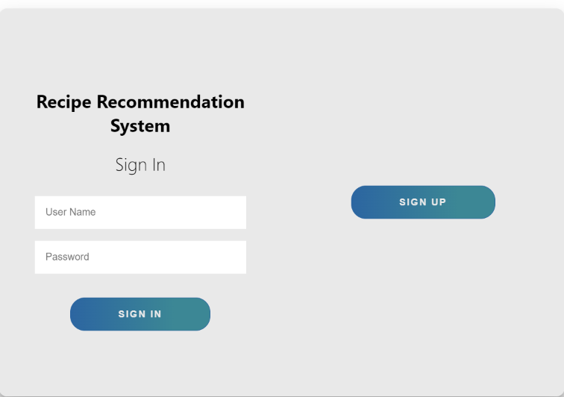
CURRENT IMPLEMENTATION

Slide 15
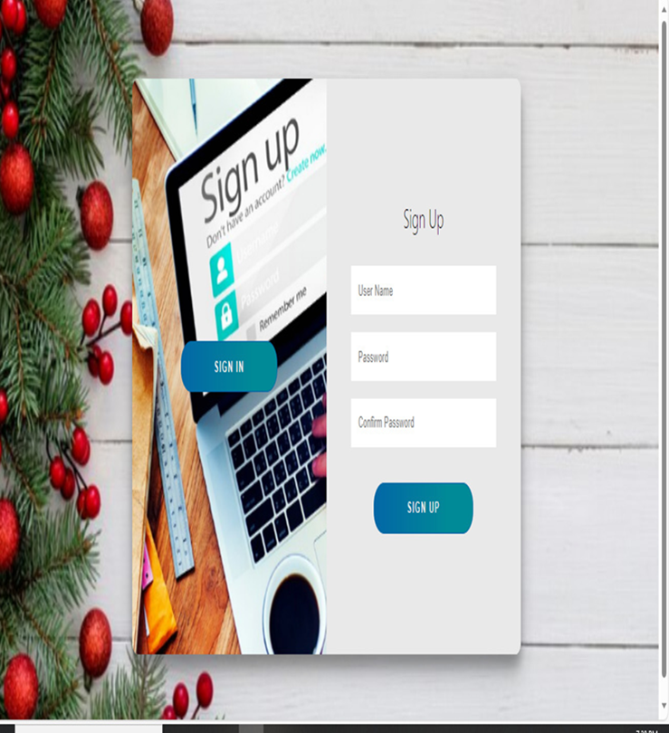
CURRENT IMPLEMENTATION

Slide 16
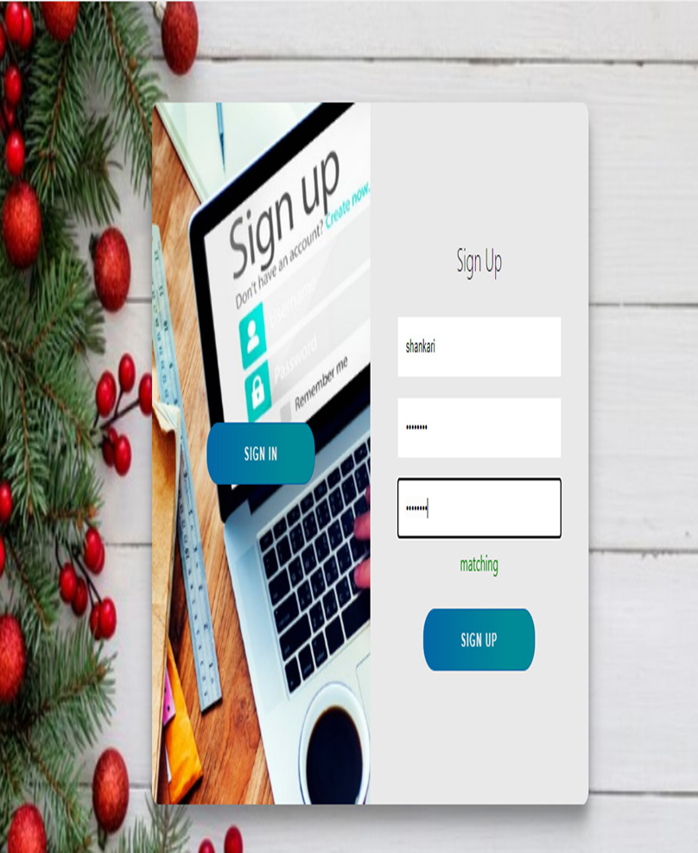
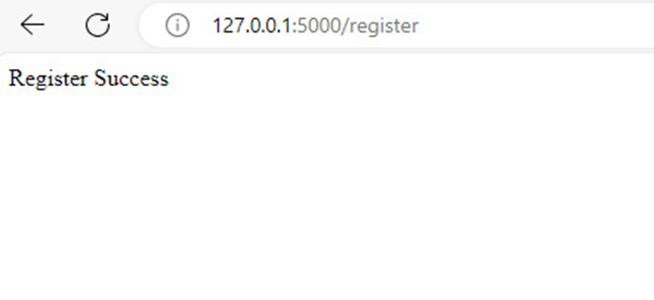
CURRENT IMPLEMENTATION

Slide 17



